Slide 1
National Tuberculosis and Leprosy Status Report
TB Situation
Aiban Ronoh
Lung health symposium 2025

Slide 2
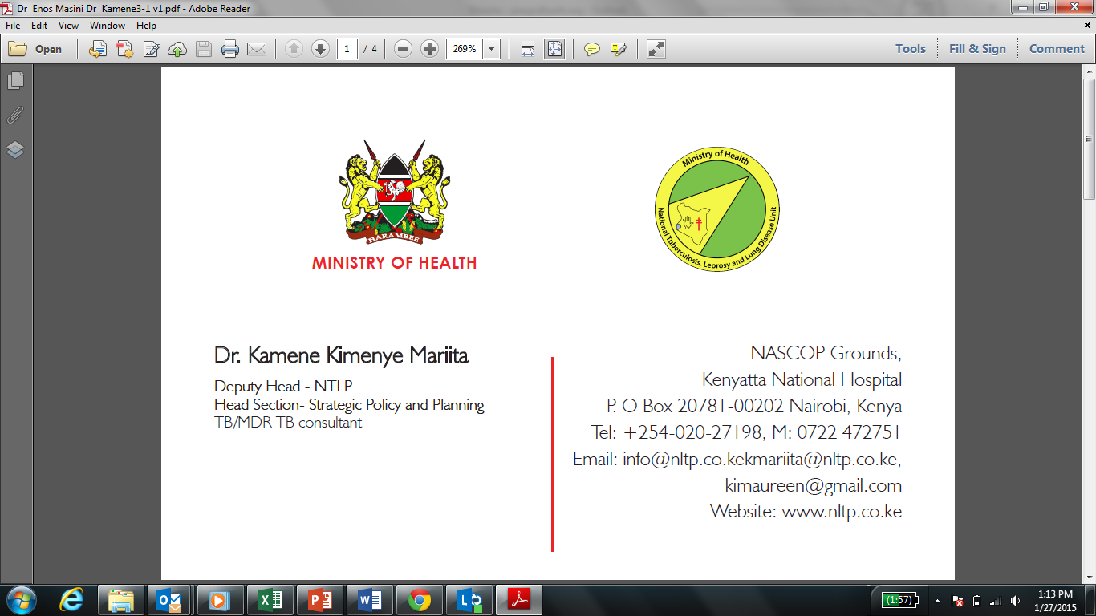


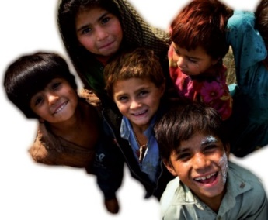
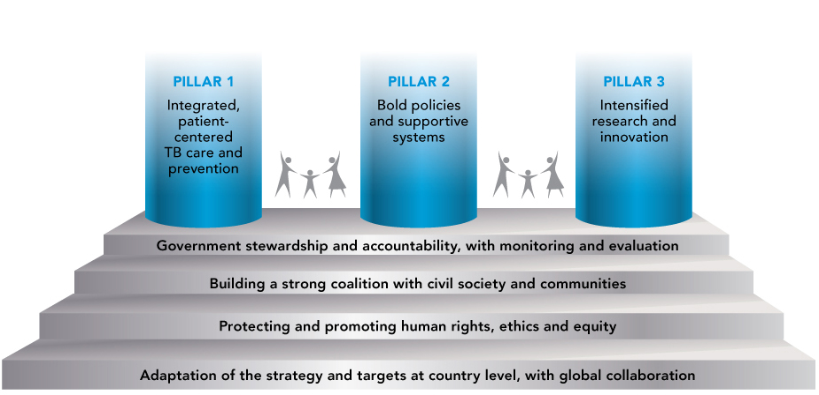
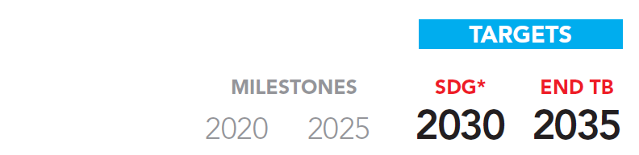
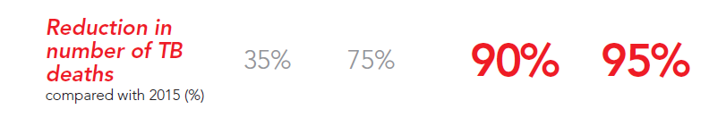
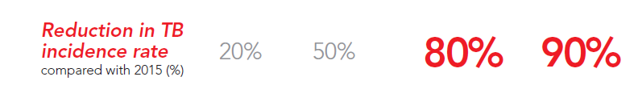
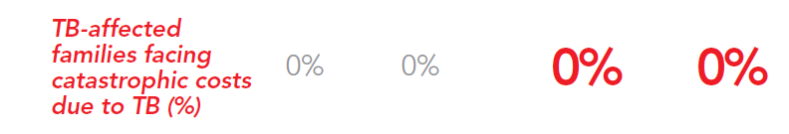




The End TB Strategy:
Vision, Targets and Pillars
Vision:
A world free of TB
Zero TB deaths, Zero TB disease, and Zero TB suffering
Goal:
End the Global TB Epidemic
Achievement
2022
42%
56%
32%
38%
Notes:
The End TB Strategy which is the vehicle expected to lead to the health- related target under the Sustainable Development Goals emphasizes building strong linkages with all health care providers.

Slide 3
Vision, Mission, Goal, and Impact of the NSP 2023/24-2027/28
Vision | Contribute to Kenya’s Vision 2030 ”to create a globally competitive and prosperous country with a high quality of life” that has zero deaths, disease, and suffering from tuberculosis
Mission | Provide equity of access to cost-effective, quality-assured TB, Leprosy, and Lung health services as close to the family as possible
Goal | End TB and Leprosy by 2030

Slide 4
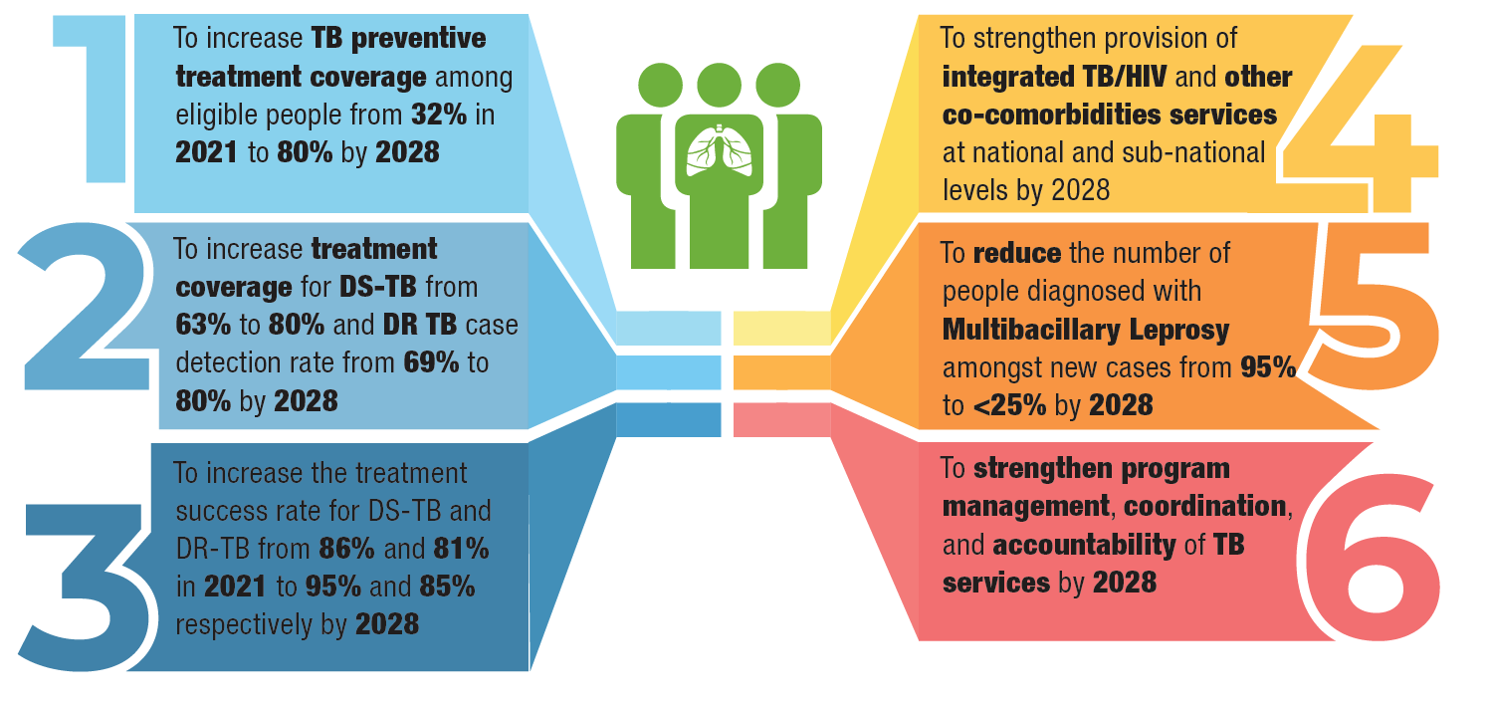
STRATEGIC OBJECTIVES

Slide 5

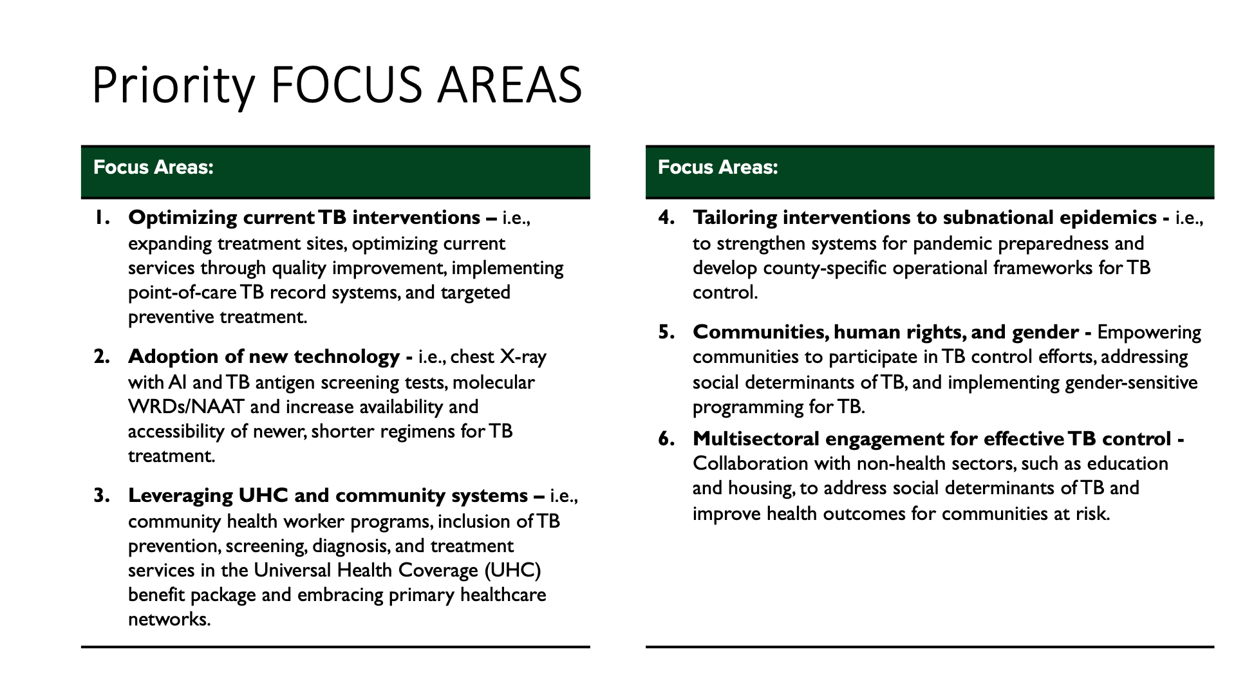
Key Programmatic Focus areas

Slide 6
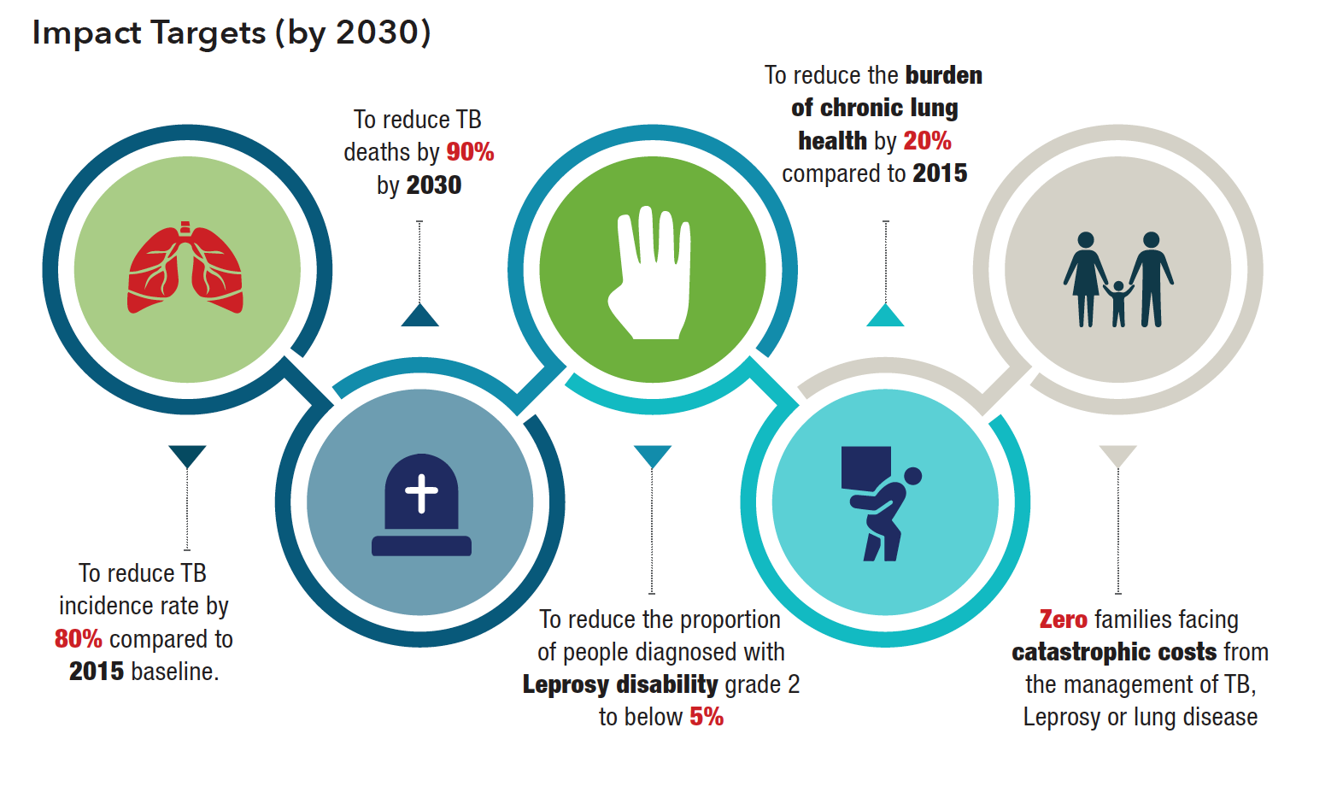
IMPACT TARGET 2030

Slide 7
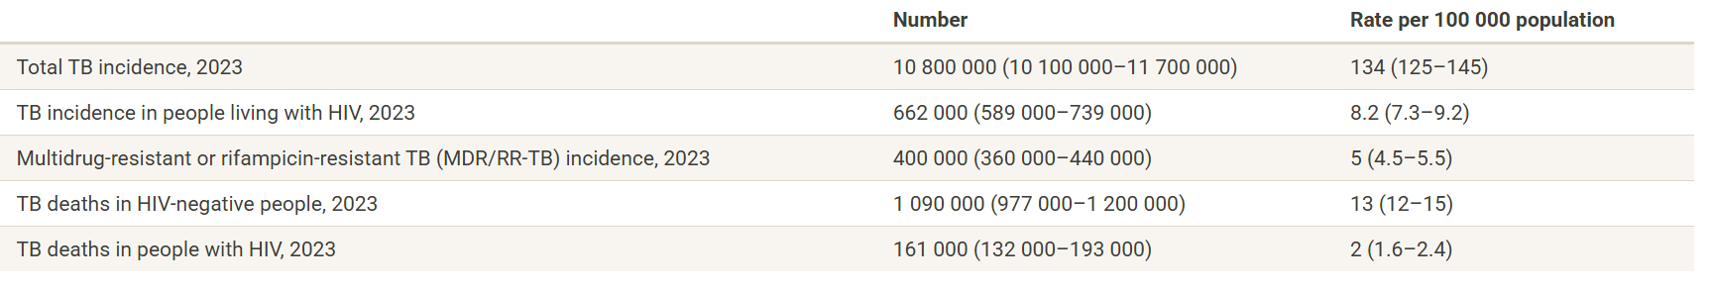
Global TB Burden
Notes:
WHO TB Global report 2024

Slide 8
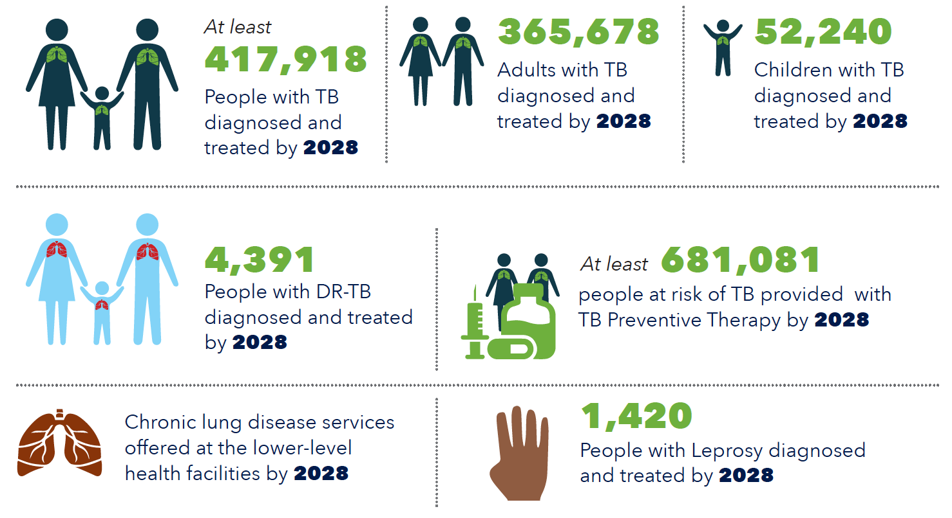
PRIORITY OUTCOME TARGETS BY 2028

Slide 9
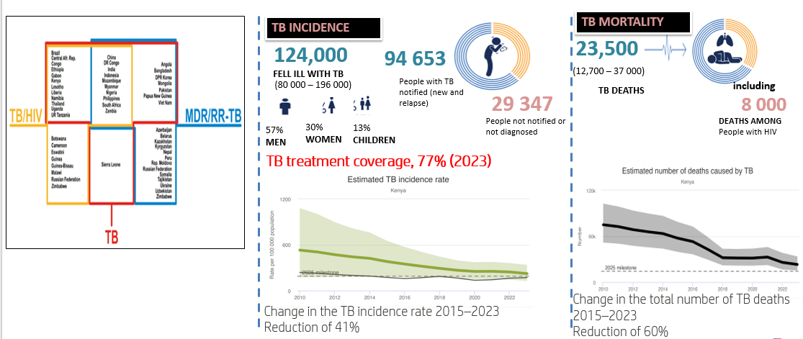

Context –Kenya TB Burden (WHO Global Report 2024)

Slide 10
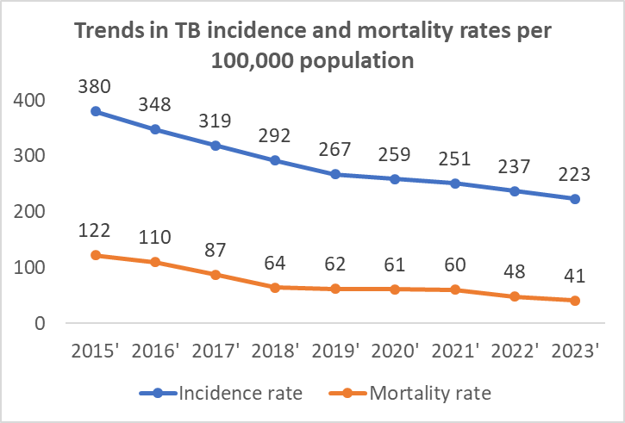
Progress towards achieving impact
41% reduction of incidence against a target of 50% by end of 2025 compared to 2015 base line
66% reduction of deaths due to TB against a target of 75% by end of 2025 compared to 2015 baseline

Slide 11
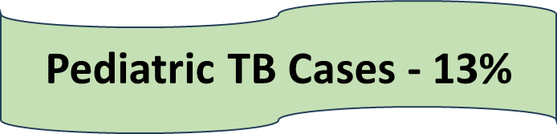
Trends in Case Finding, 2011-2024

Slide 12
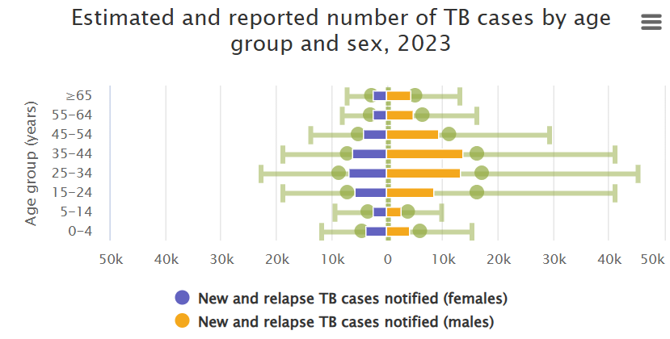
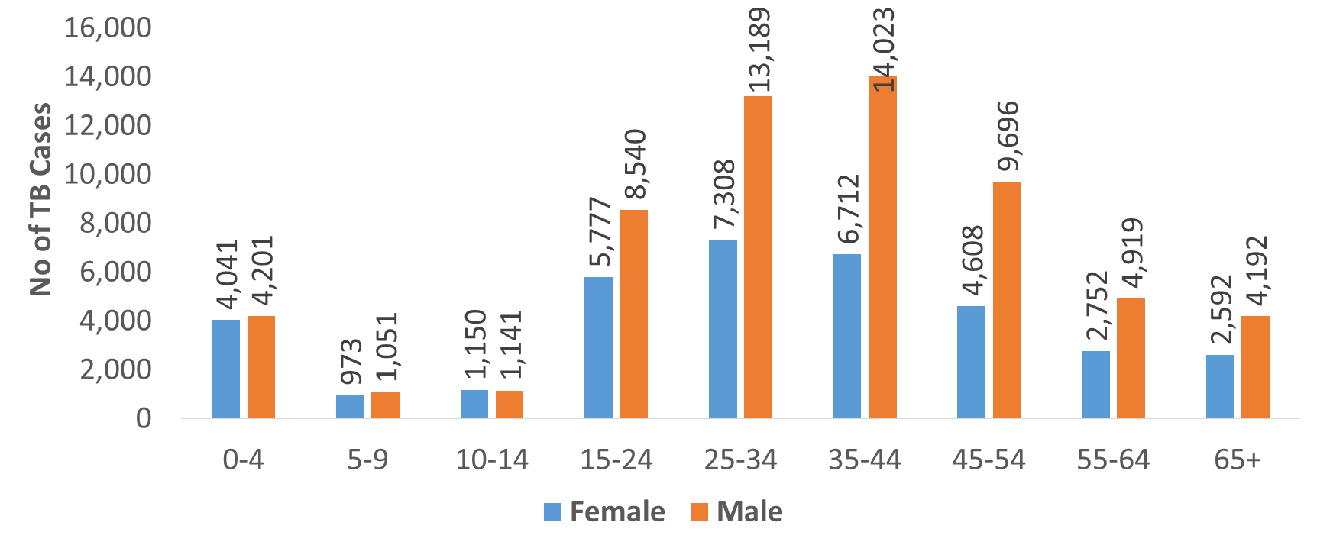
Age-Sex Distribution for TB cases

Slide 13
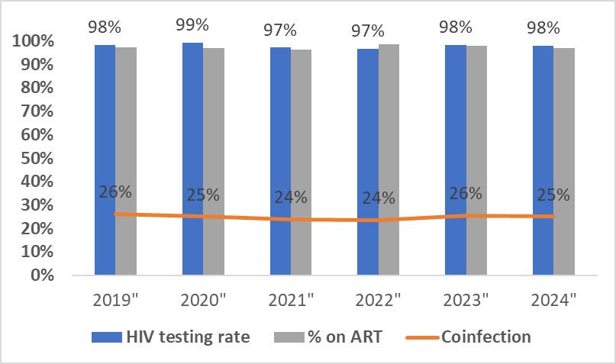
Trends in TB/HIV care cascade :2020-2024

Slide 14
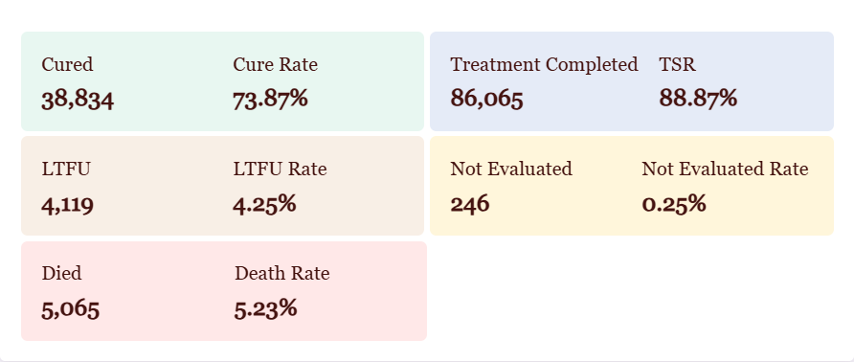
TB Treatment Outcomes:2023 cohort

Slide 15
DR TB Notifications trends 2020:2024

Slide 16
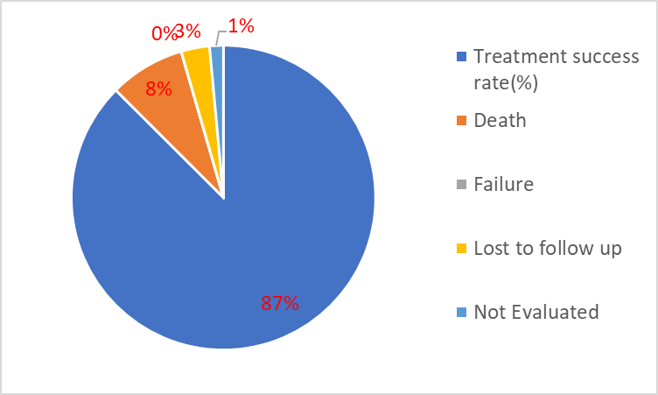
Drug resistant TB treatment outcomes 2022

Slide 17
TB contacts screening cascade: 2024

Slide 18
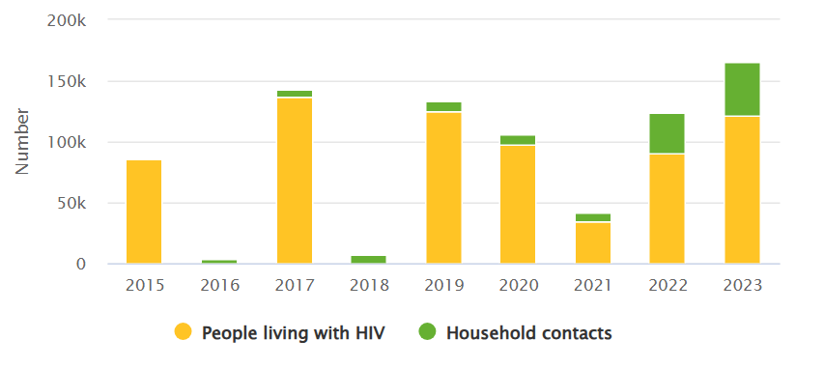
Trends of people provided with TPT

Slide 19
UHC and Social protection indicators
Global
75%(70-81)
12%(10-13)
49%(38-60)

Slide 20
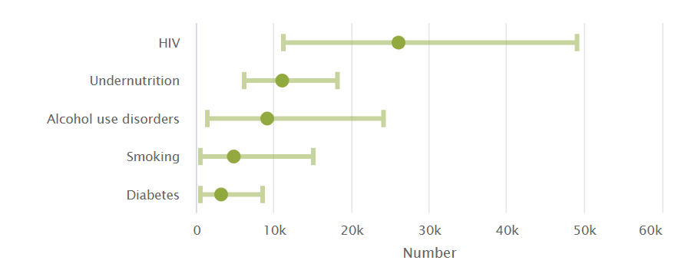
TB Risk factors

Slide 21


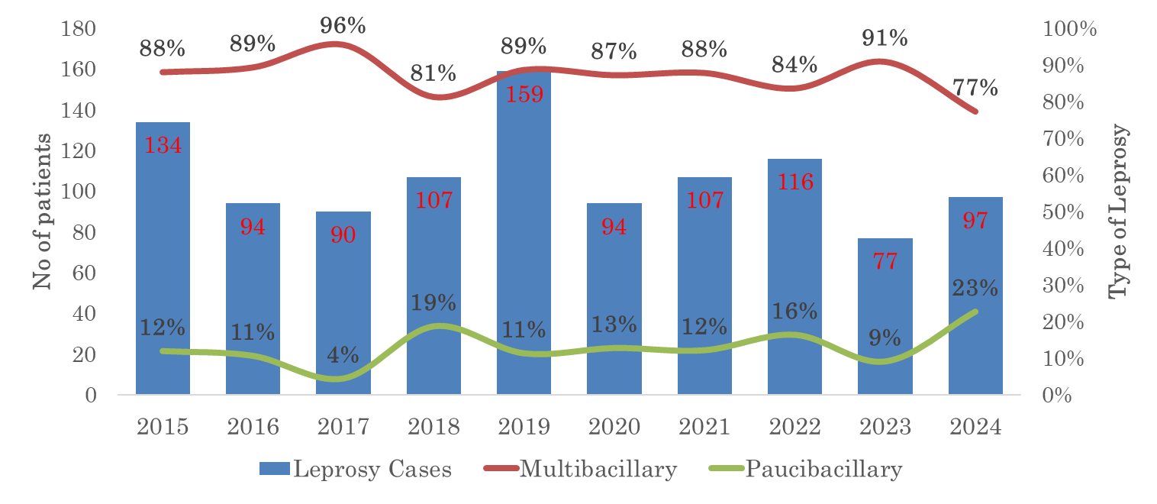
Leprosy Case Finding Trend in Kenya, 2024
97
(From 19 Counties)
Cases in 2024
The country had an increase in leprosy cases from the endermic and non endermic counties from 77 in 2023.
County | Patients
Kilifi | 35
Homa Bay | 10
Kwale | 10
Busia | 6
Mombasa | 6
Siaya | 6
County | Patients
Kisumu | 5
Turkana | 4
Kajiado | 2
Meru | 2
Migori | 2
West Pokot | 2
One patient from Bomet, Bungoma, Kakamega, Kiambu, Kitui, Machakos and Nyamira

Slide 22
Research agenda-Ongoing/planned studies
Program established national research task force for TB with clear mandate and TORs to coordinate research activities and some of the planned activities include;
KVP prioritization, mapping and size estimation
SMART4TB study in Kisumu
Inventory study
Patient cost survey
Burden of lung disease
digital X ray/ AI validation study
The program will be organizing bi-annual dissemination meetings for research

Slide 23
TB and Lung health Funding landscape

Slide 24



National Tuberculosis, Leprosy and Lung Disease Program nltp.co.ke @NTLDKenya NTLDKenya Asante (Thank You)!

